Slide 1






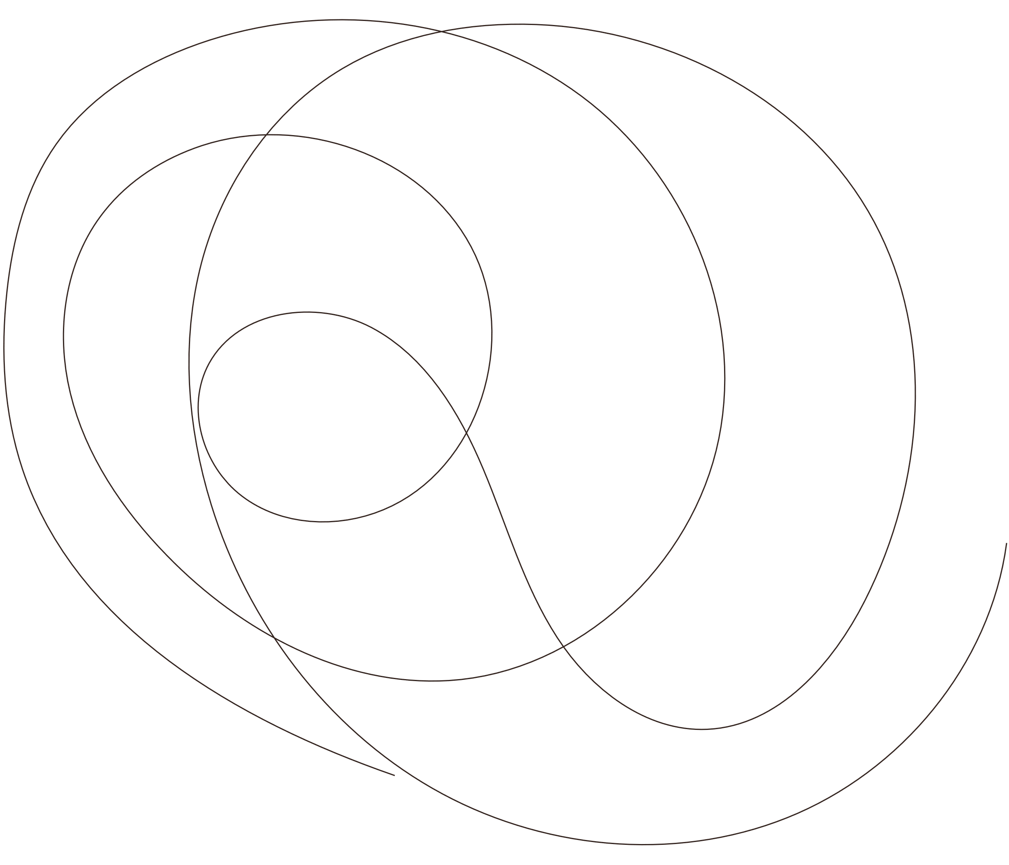
LifeBot : AI health companion for everyone

Slide 2
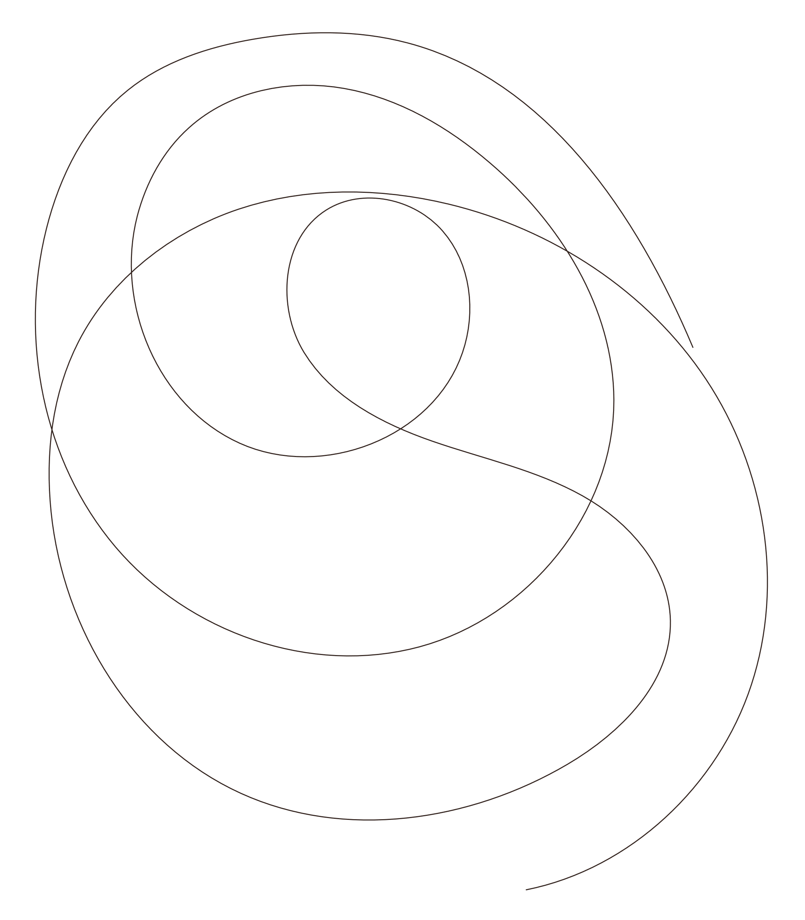

Project Overview
All-in-One Health Monitoring – Our device is a non-invasive diagnostic tool that measures multiple health parameters, including SpO₂, respiration rate, stress levels, BP, temperature, AQI, pulse, arrhythmia, and glucose trends.
Smart Features & Accessibility – It supports multilingual speech output and mobile app integration for real-time health tracking and automated medical report generation.
Advanced Technology Integration – The system combines hardware sensors, AI for risk prediction, and a microservices-based software architecture using MQTT, REST APIs, PostgreSQL, MongoDB, and Docker.
Goal & Innovation – We aim to improve accessibility, accuracy, and ease of use while introducing new features in both hardware and software for a better healthcare experience.

Slide 3
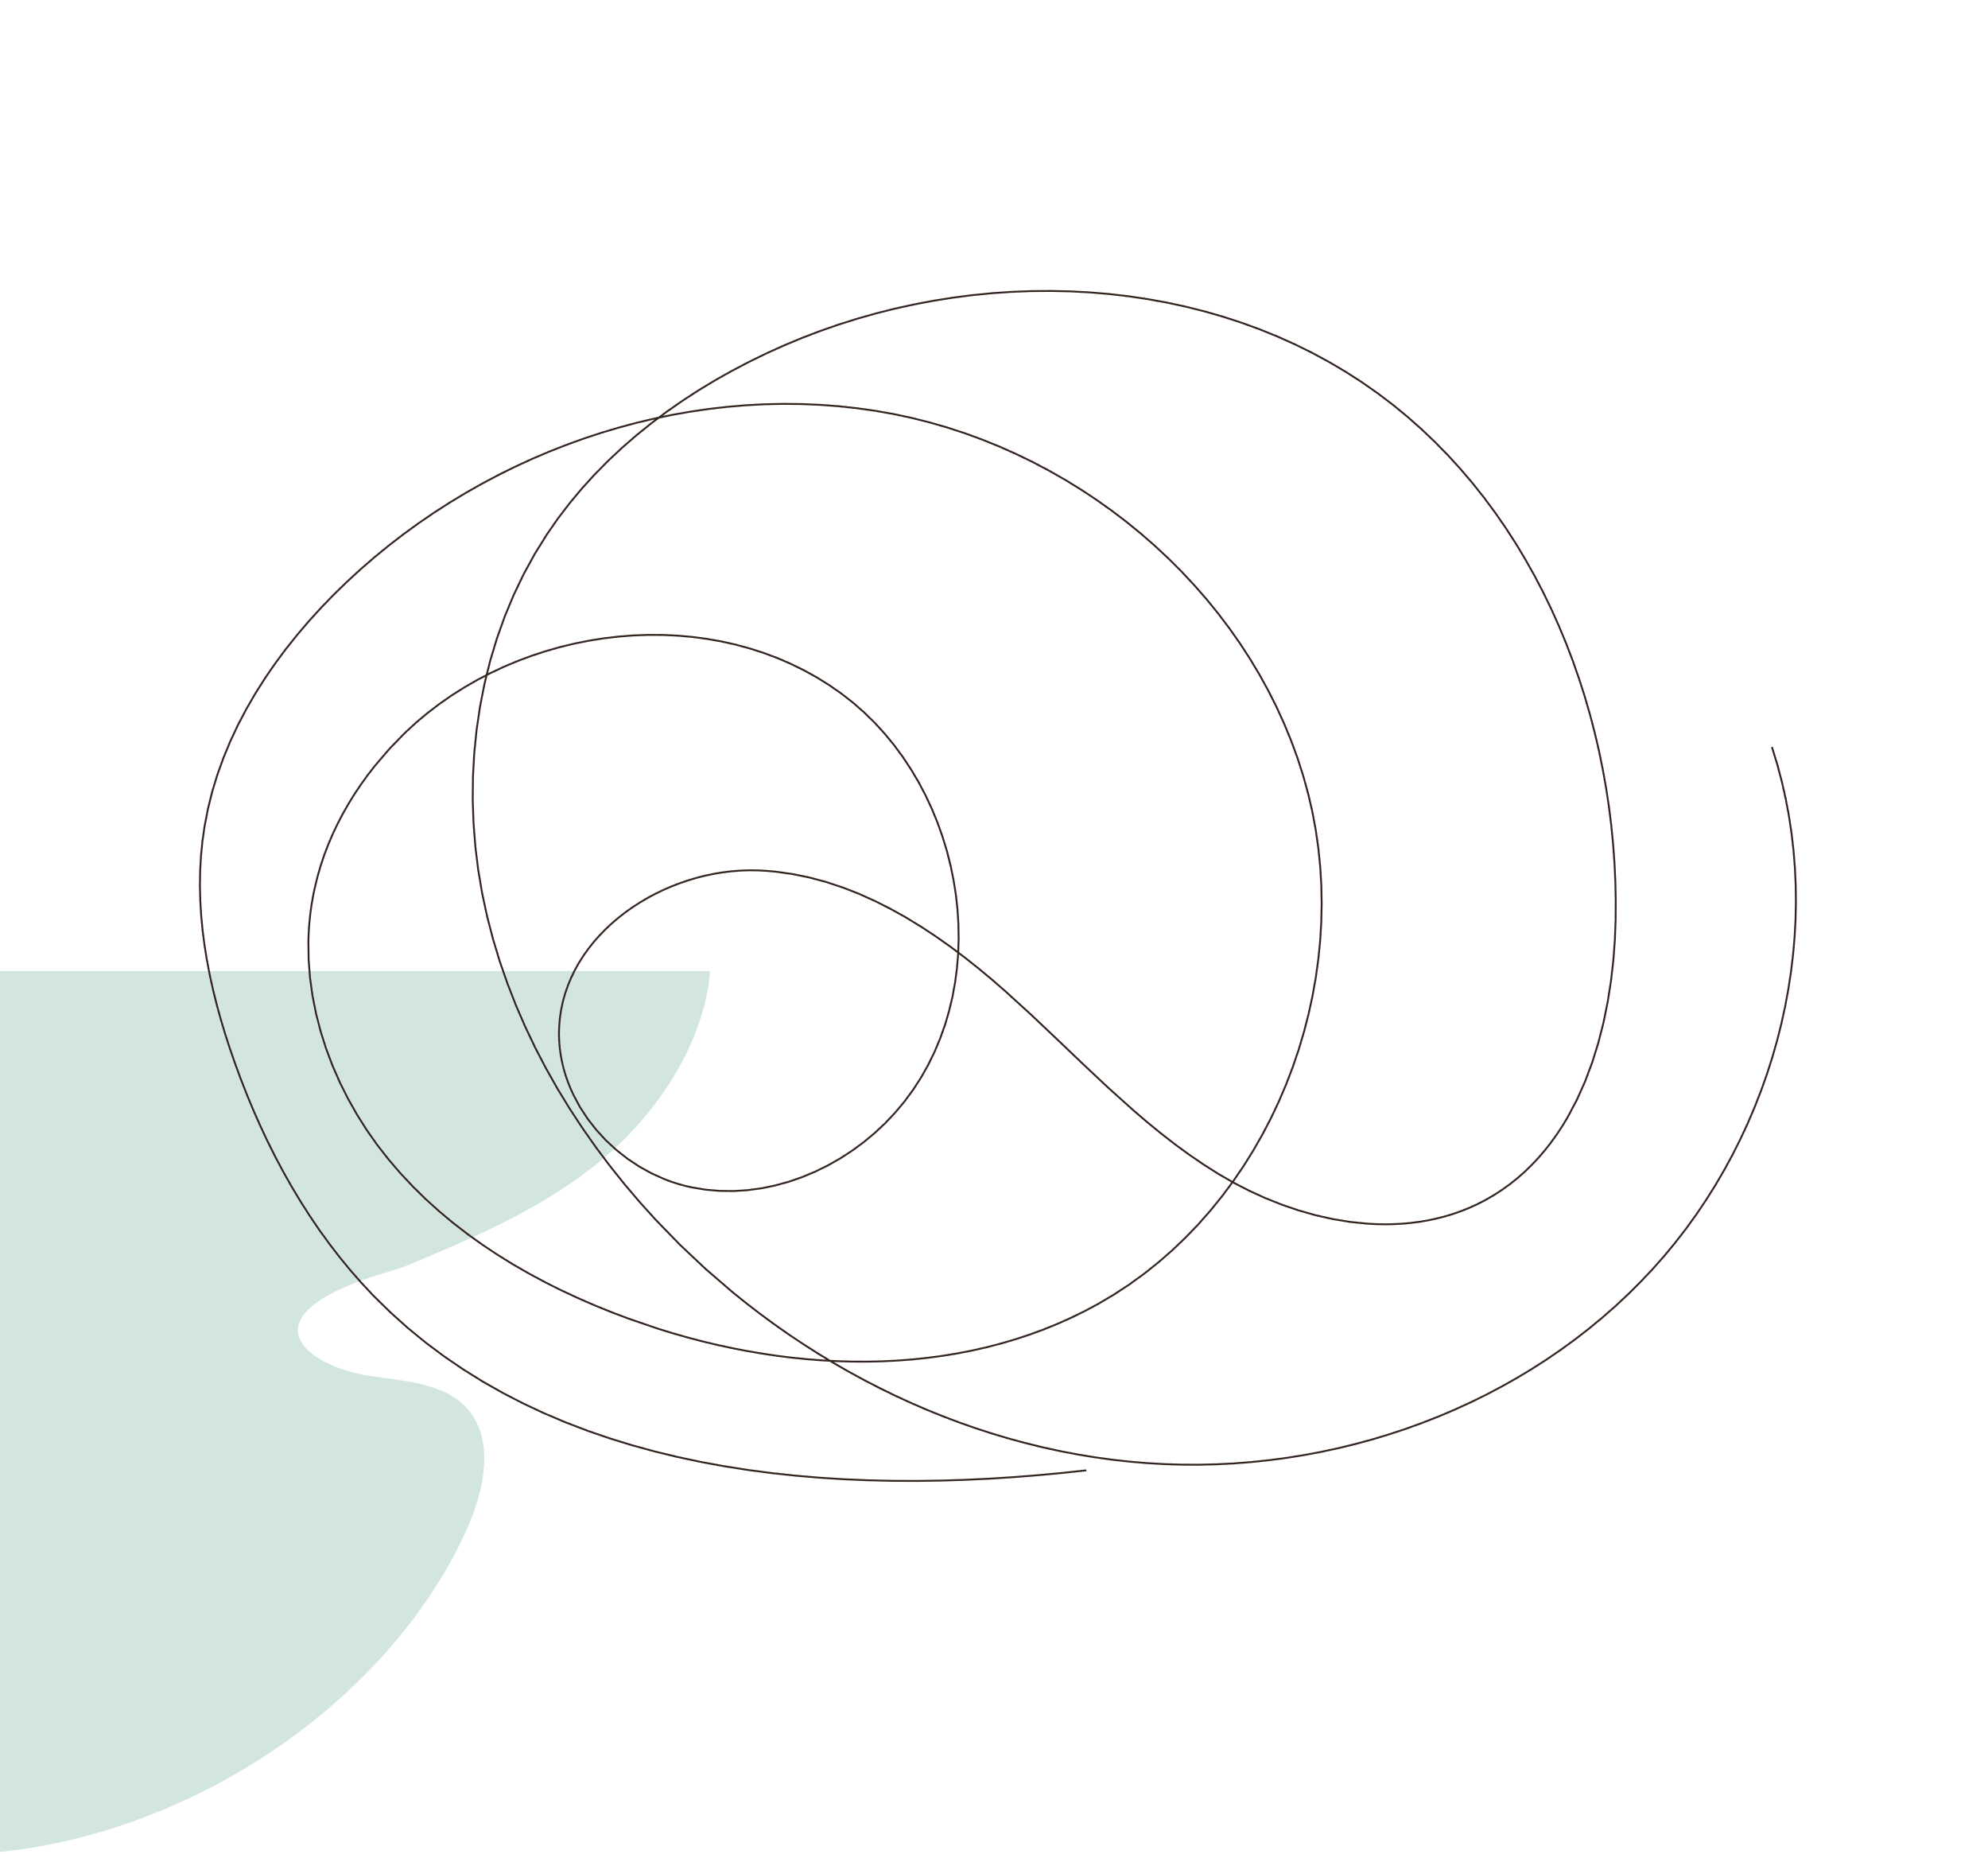


Novelty
This has been a very heavy word for our group in the past few days

Slide 4

Novel Factors
01
02
03
Multilingual voice-based accessibility
Advanced multimodal Machine
AI-driven risk analysis & doctor recommendations
04
05
Automated health report structuring & trend analysis
Personalized diet & lifestyle plans based on live health data

Slide 5
WHY?
Why is LifeBOT needed?

Slide 6
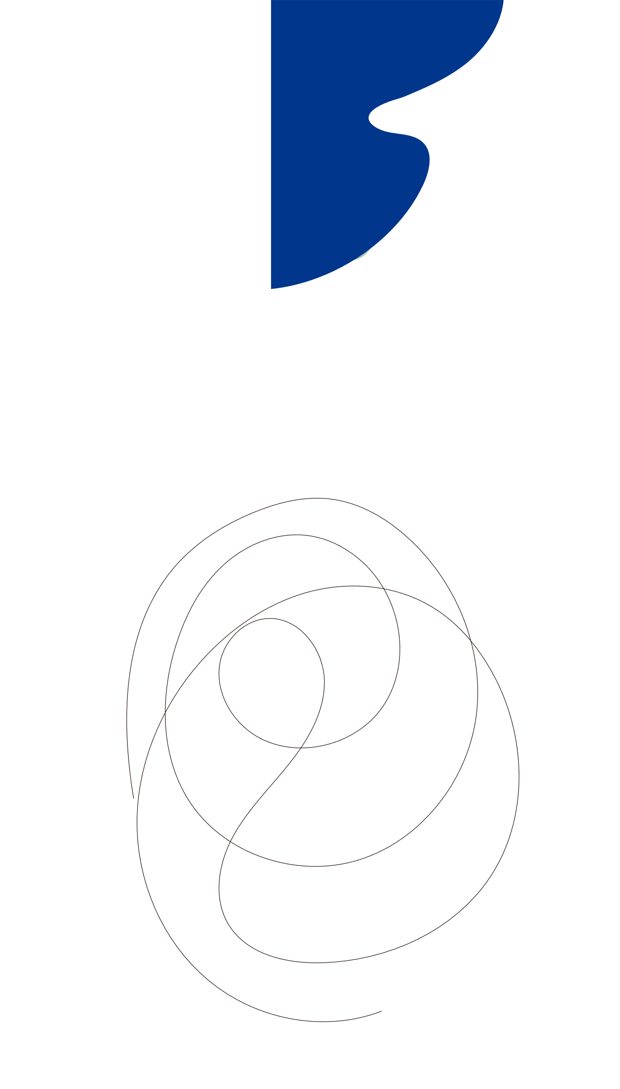

5,000,000
Deaths occur annually due to poor healthcare access

Slide 7



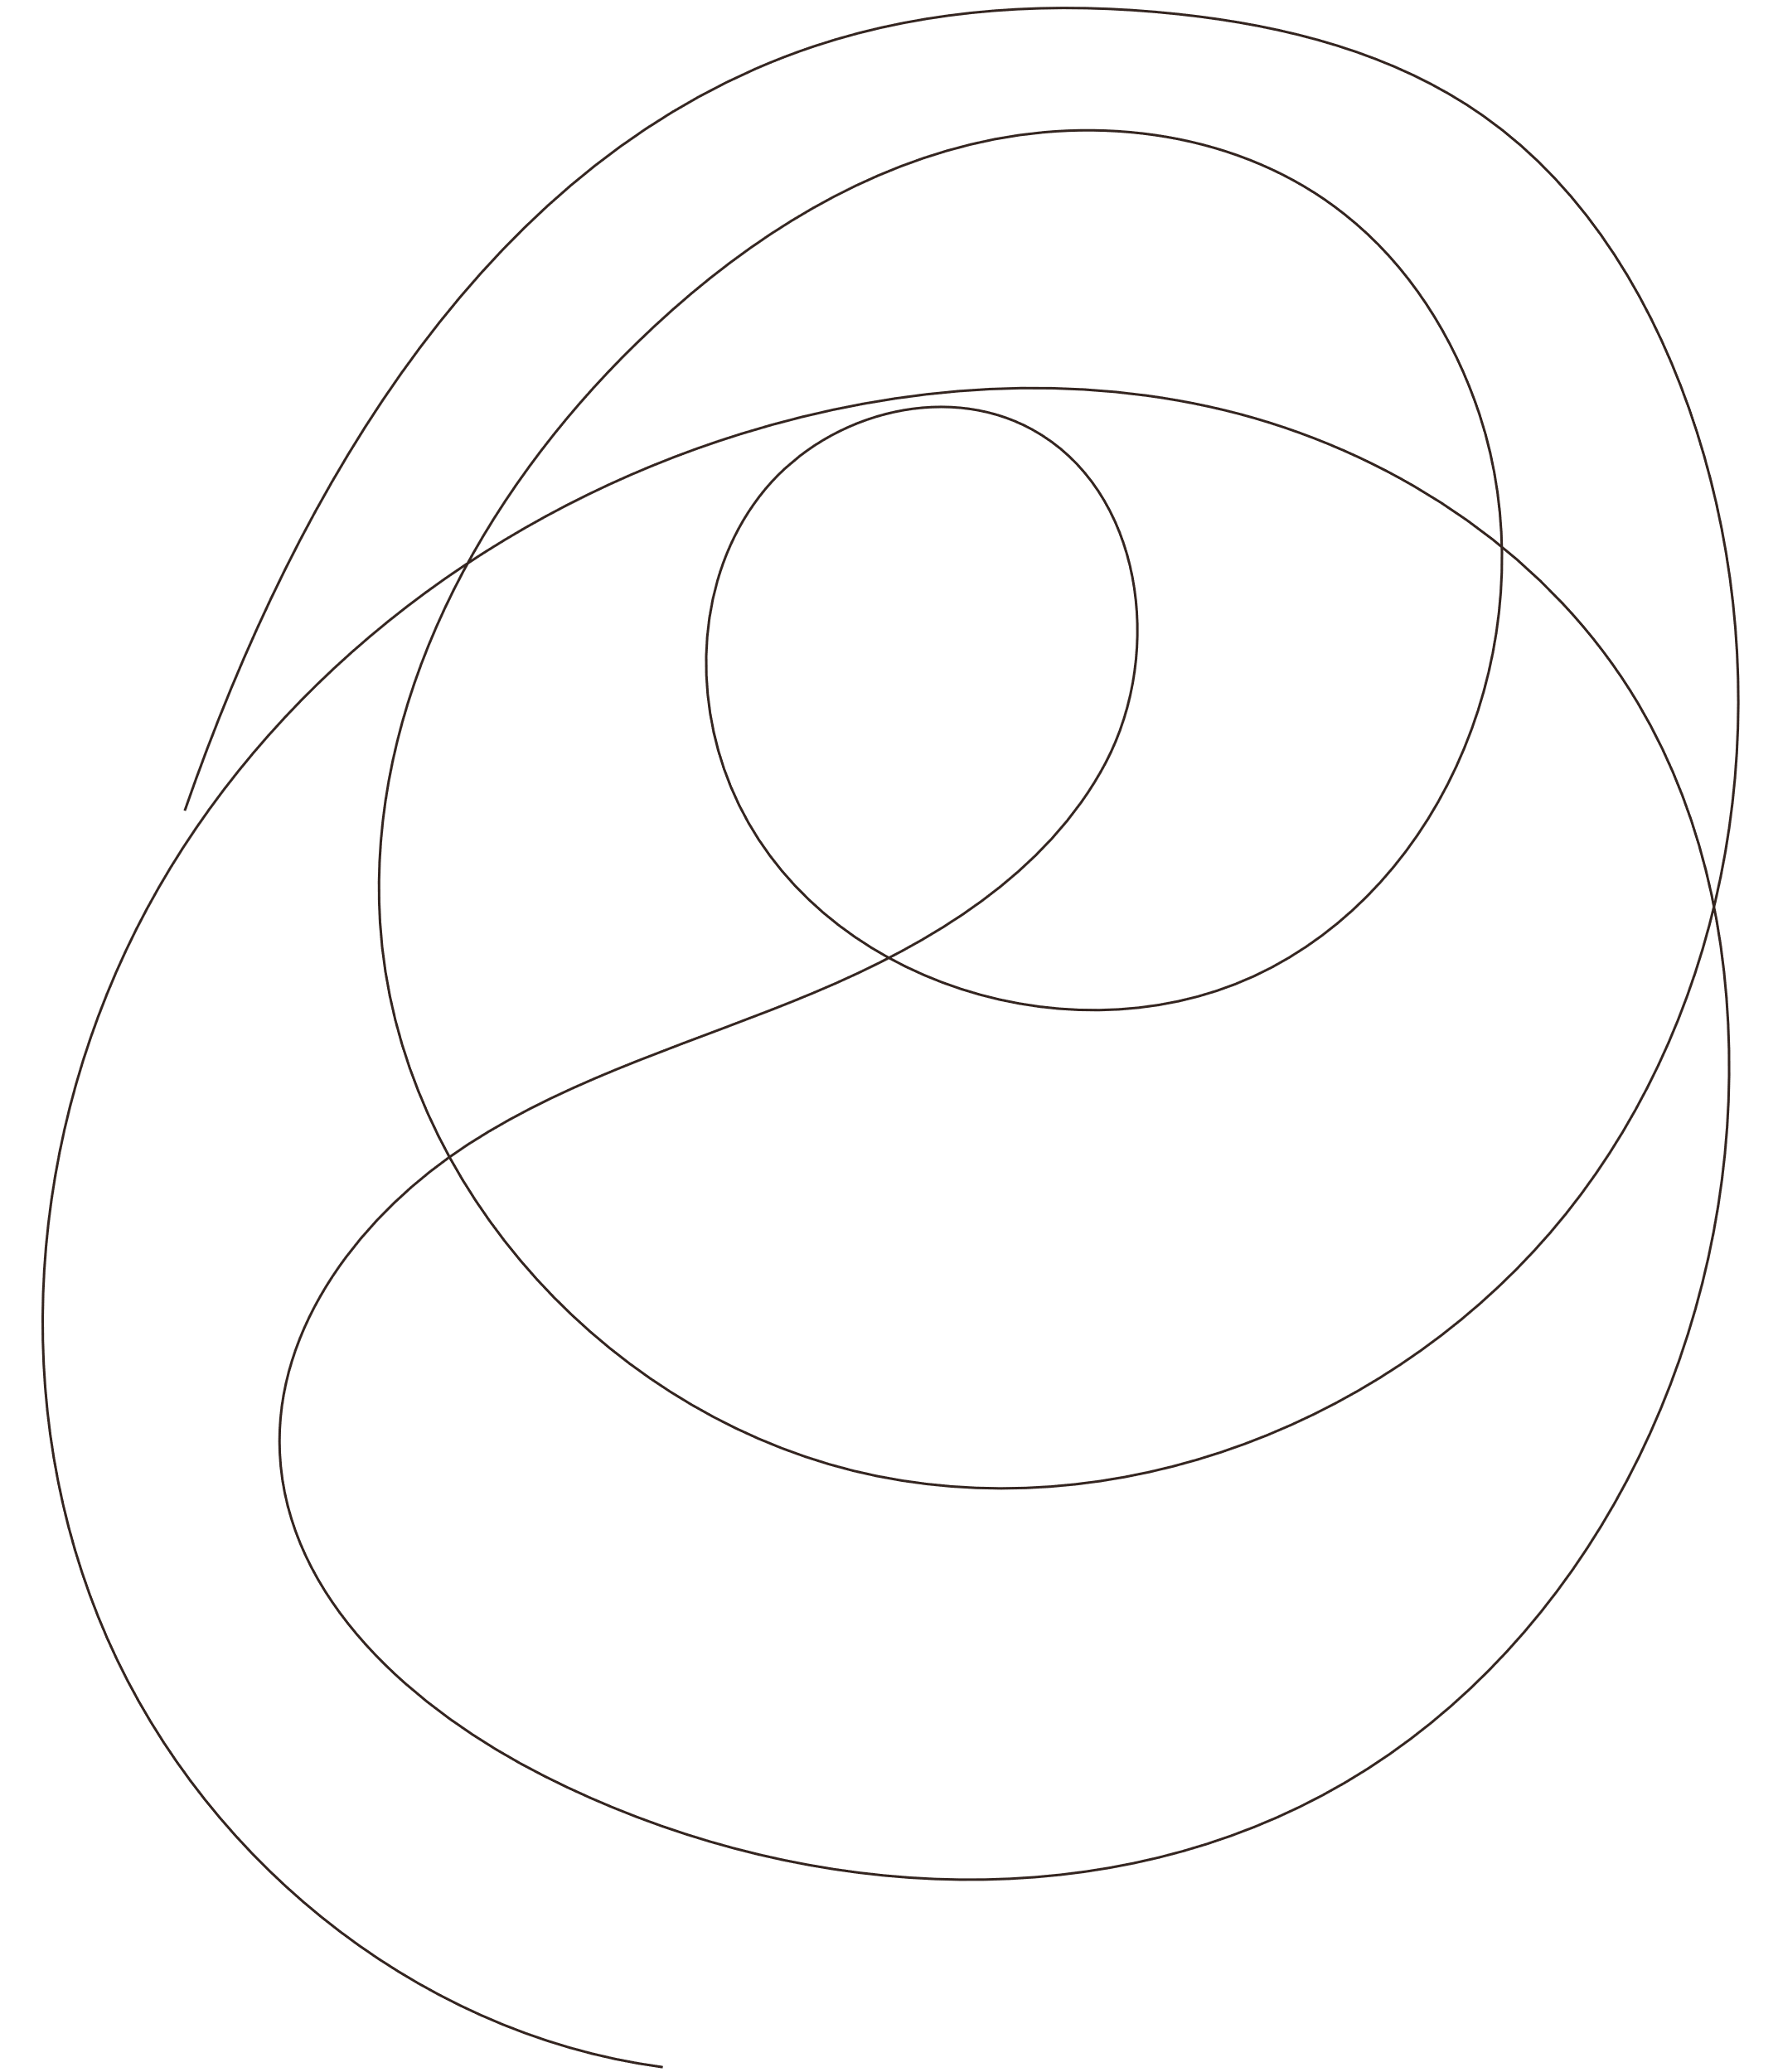
“As a healthcare professional, I observe that managing health effectively is a struggle for countless patients. I strongly believe Life Bot is not just a technological advancement but a much-needed step toward a healthier future for society”
—Dr. Harinder Jit Singh Gill (Fortis Hospital)

Slide 8
Hardware
What Hardware are we using?

Slide 9


Parameters And Sensors
SpO2 | MAX30102
Pulse Rate | MAX30102
Arrhythmia Detection | MAX30102 + AD8232 (For ECG)
Temperature | MLX90614
Stress(Non-Invasive) | GSR + AD8232 (HRV Analysis)
Respiration Rate | FFT on MAX30102 / AD8232 Signal
Blood Pressure | PTT Method
Glucose | CGM Technique
Microcontroller | ESP32
Speaker (For Output) | DF Player

Slide 10

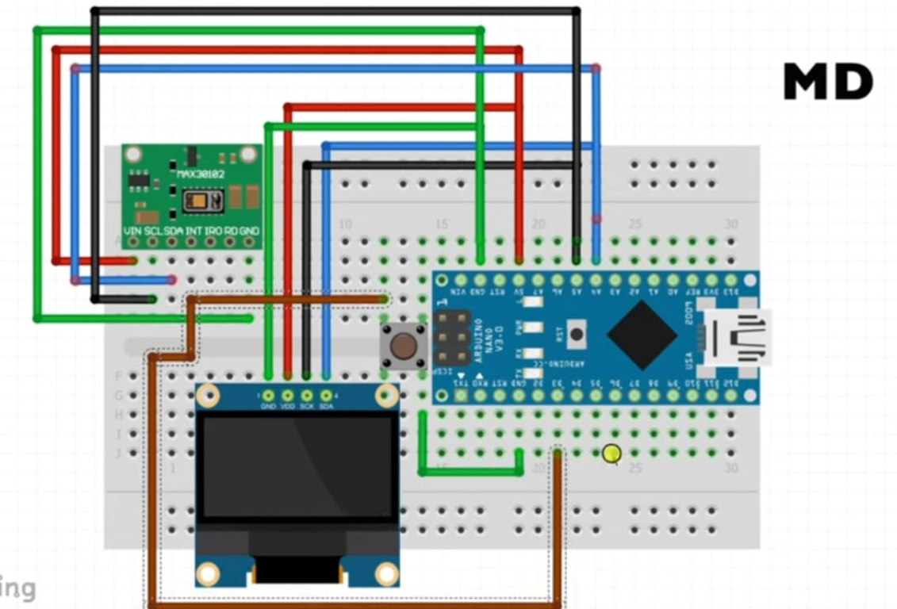
Example : SpO2 and Pulse
ESP32
MAX30102
OLED Display

Slide 11
Software
How will the data flow from Hardware to Application

Slide 12
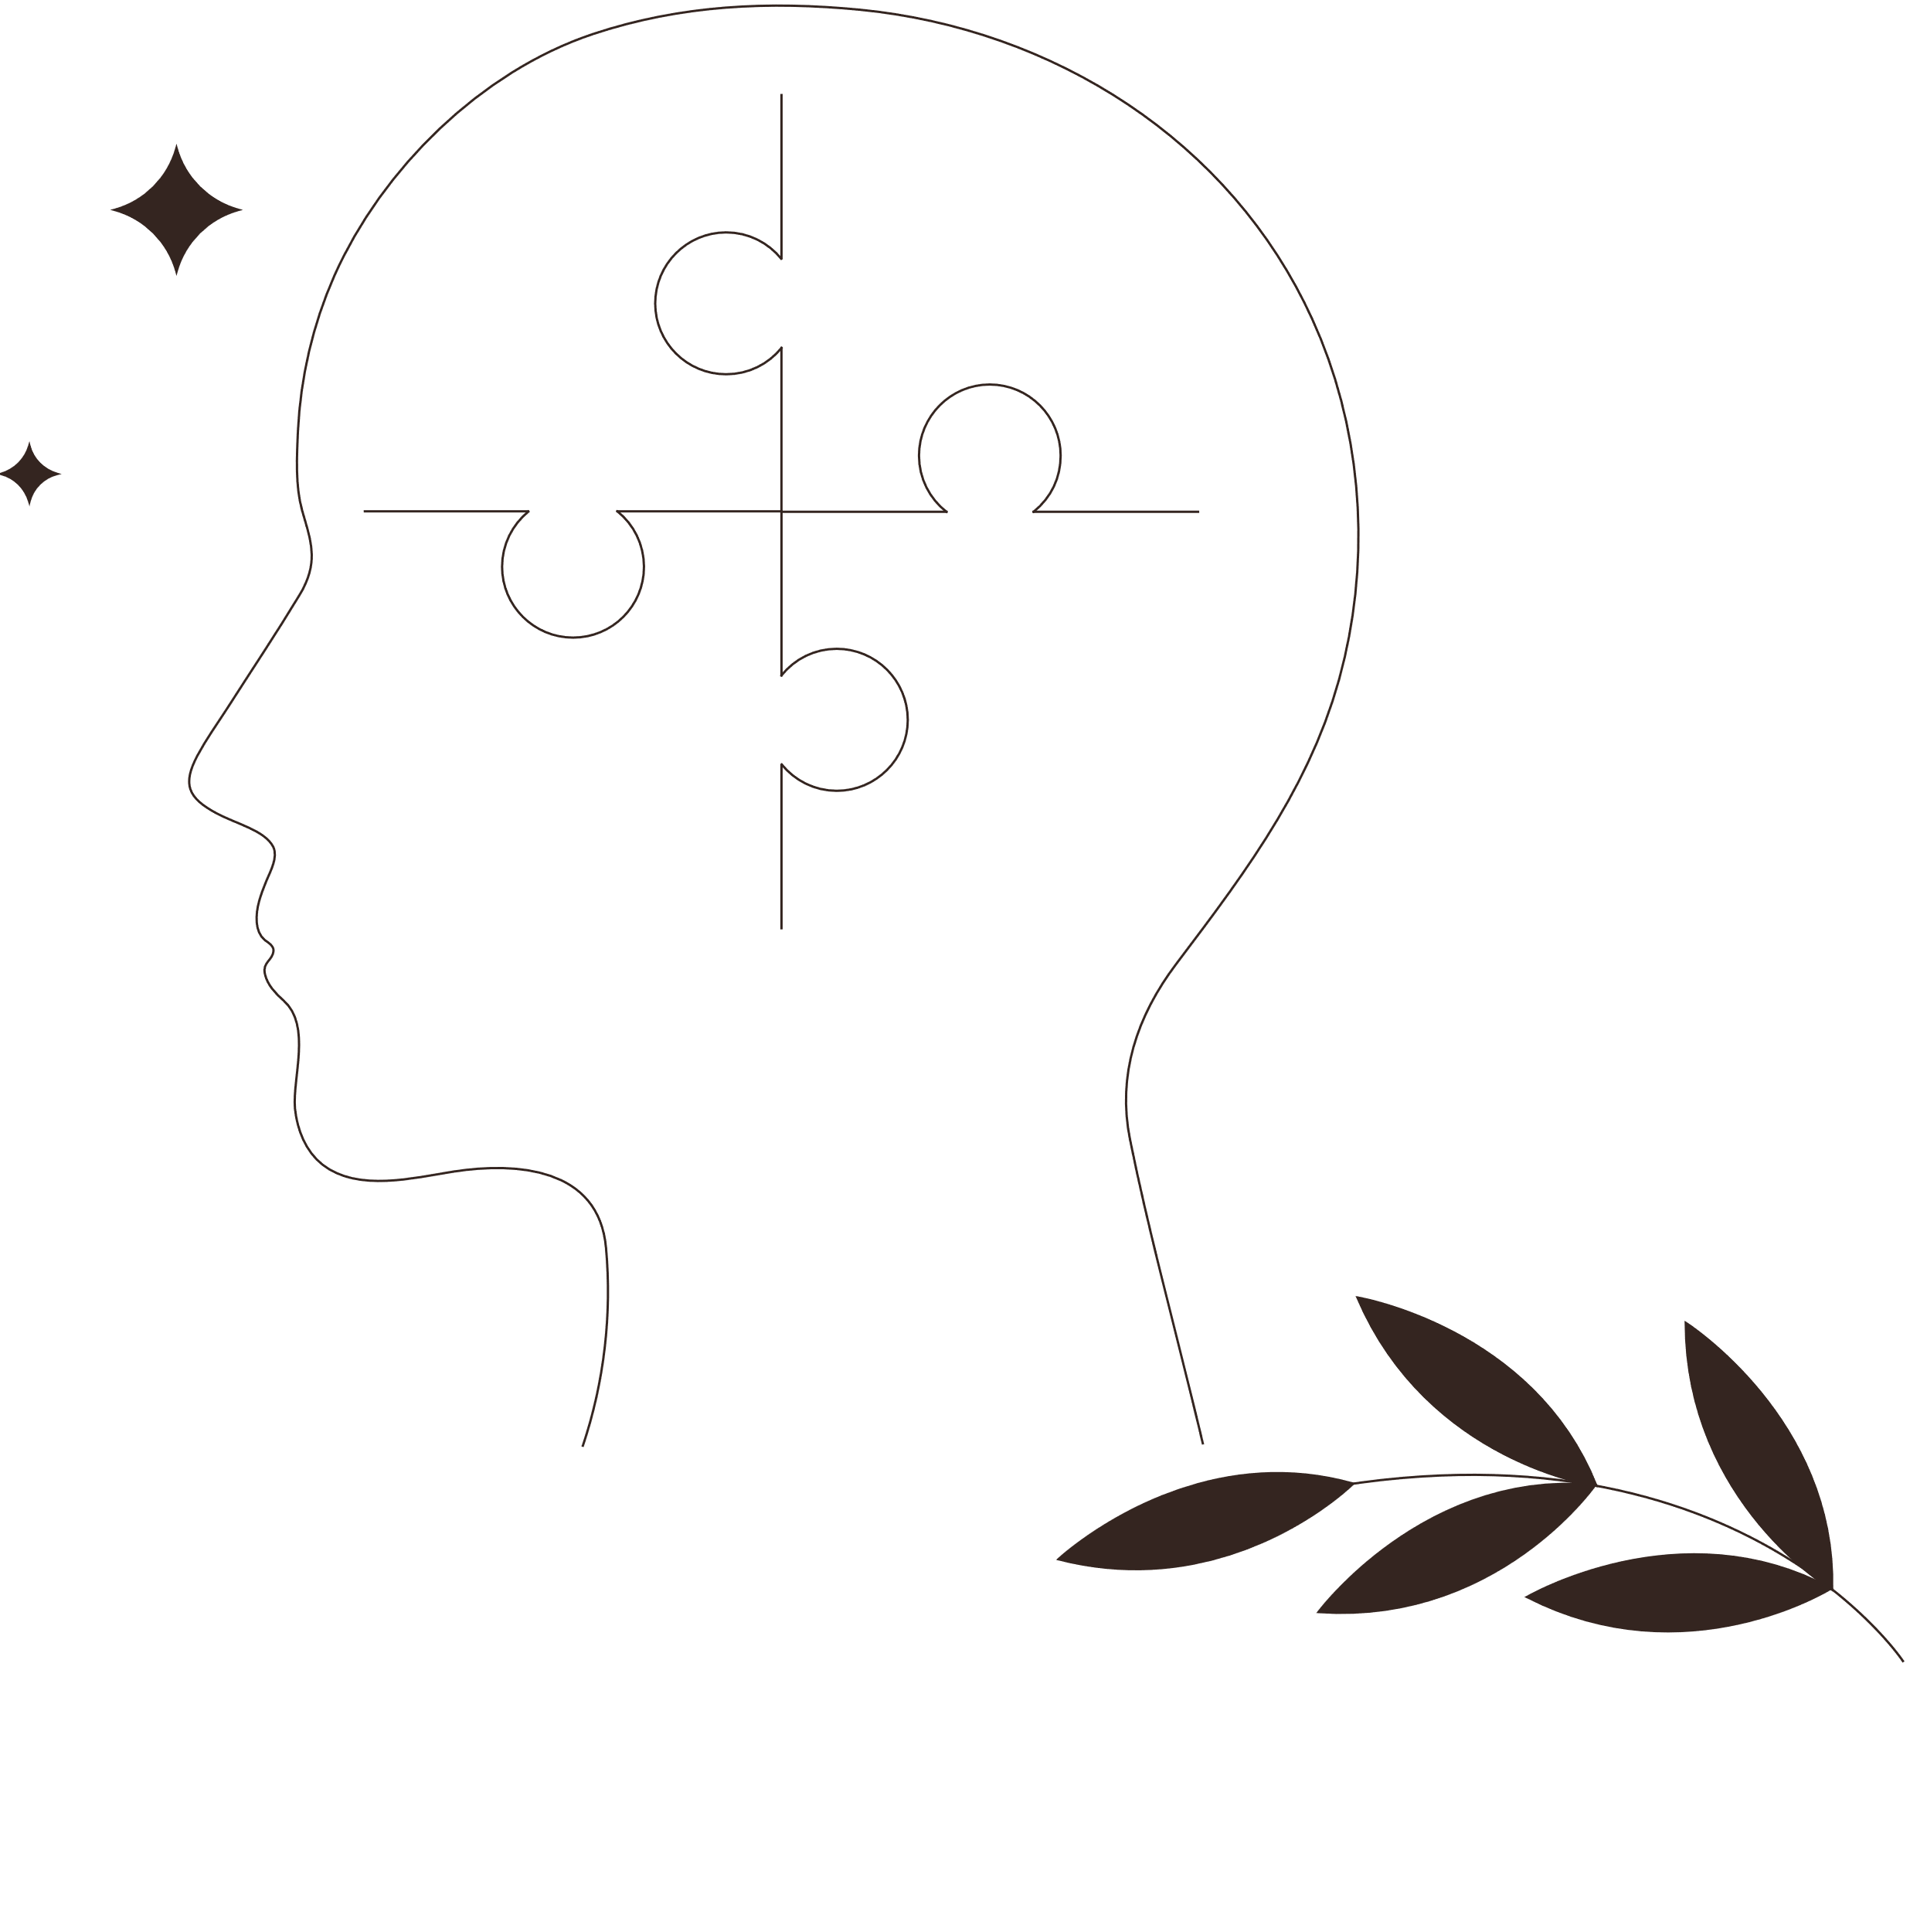
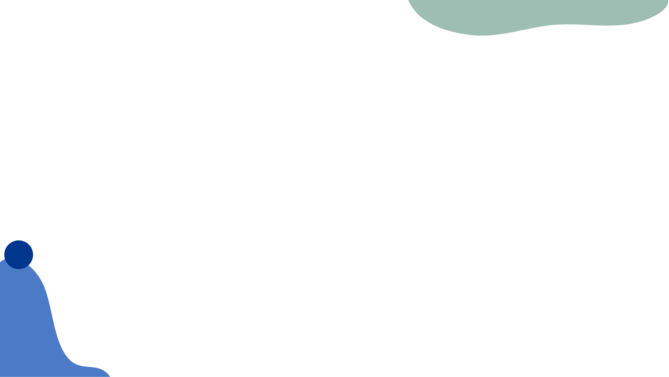
ML Model Workflow
1. Medical reports & real time health data are sent from the backend to the ML model via Fast API/Flask.
2. OCR (Tesseract/Google Vision API) extracts text from scanned reports and PDFs.
3. NLP (spaCy/NLTK/Transformers) processes extracted data and identifies key health parameters.
4. Machine learning models (TensorFlow/PyTorch/Scikit-learn) analyze health patterns and predict risks.
5. Risk assessment and doctor recommendations are generated and returned to the backend via REST API.

Slide 13
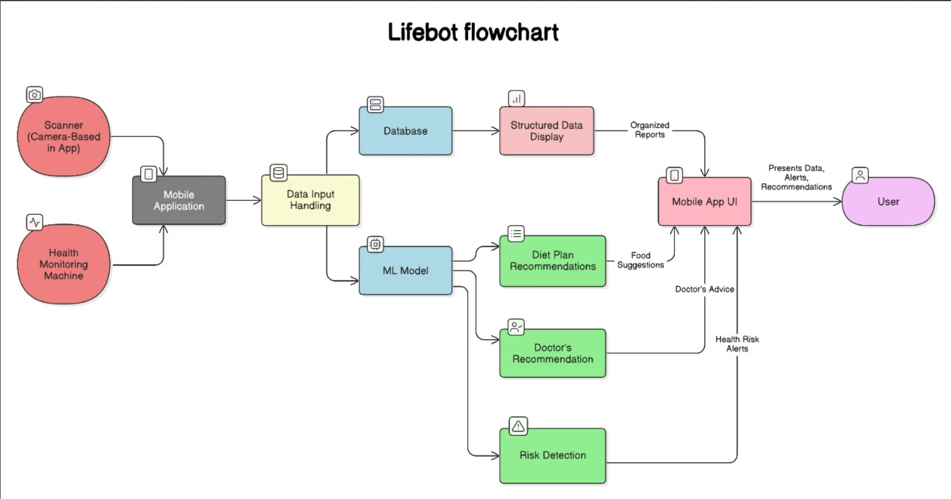

Slide 14
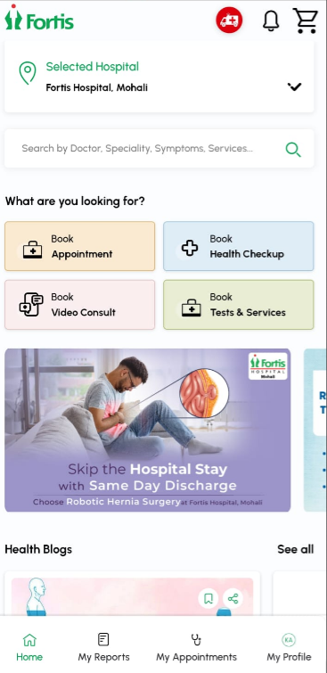
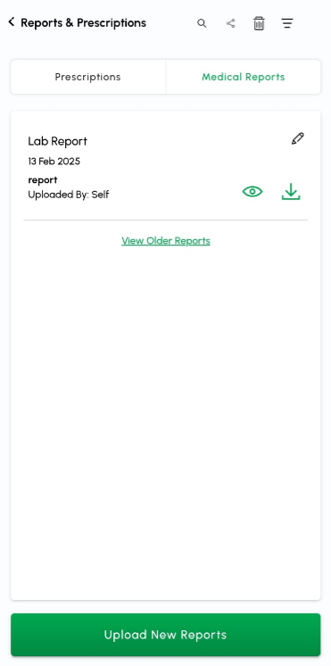
Existing Competitors

Slide 15
Frontend
1. User logs in using Firebase/Auth0 authentication integrated via React Native/Flutter.
2. Medical reports are uploaded and scanned using the app’s built-in camera with OCR (Tesseract/Google Vision API).
3. Health data from Bluetooth (BLE) devices is read and transmitted to the app using reactnative-ble-plx.
4. The app communicates with the backend via Axios/Fetch API to request AI insights.
5. Received AI-based health recommendations and alerts are displayed using Redux Toolkit & Material UI/Tailwind CSS.
6. Push notifications for critical alerts are managed using Firebase Cloud Messaging (FCM)

Slide 16
Backend
1. User authentication and access control are managed using JWT/OAuth via Node.js (Express.js) or Django REST Framework.
2. API Gateway (Kong/Nginx) routes frontend requests to appropriate backend microservices.
3. Health data from Bluetooth (BLE) devices is first received by the mobile app and then transmiƩed to the backend via REST API calls.
4. The Backend's Bluetooth Data Processing Service: Validates and structures incoming health readings and stores data in PostgreSQL/MySQL (for structured health records).
5.Microservices communicate using REST APIs & Message Queues (RabbitMQ/KaŅa) to ensure asynchronous processing.
6. Docker & Kubernetes are used to containerize and orchestrate backend microservices for deployment.

Slide 17
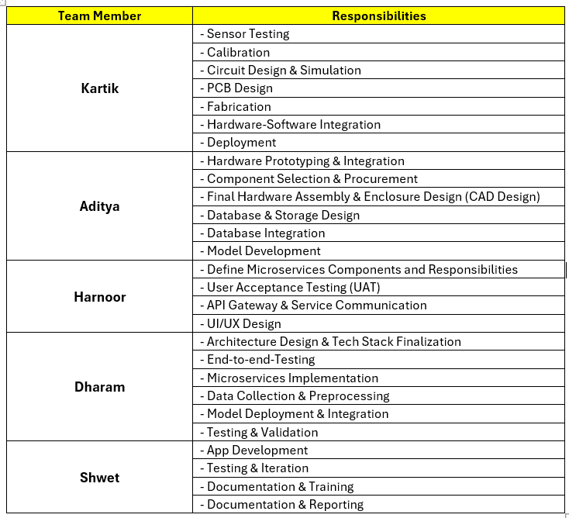
Individual Roles

Slide 18
Vision
So at the end of our capstone project we aim to achieve:
To develop an AI-powered health monitoring system using advanced sensing techniques.
To use AI analytics for real-time risk detection and automated health reporting.
To provide personalized health and lifestyle recommendations based on medical conditions.
To ensure secure, scalable data management with cloud integration and a user-friendly mobile interface.

Slide 19
Thank You!

